Slide 1
Travel Bug
A travel planner
Sumedh shah
Noopur Latkar
Rohit sanyal

Slide 2



Team Non-Interpreters
Rohit Sanyal
rohitsan@andrew.cmu.edu
Sumedh Shah
sumedhns@andrew.cmu.edu
Noopur Latkar
nlatkar@andrew.cmu.edu

Slide 3
Problem
Customer Pain
Fetch flights on multiple websites to compare and analyze the best option
Explicitly look for top attractions on the internet
Check tourist spot locations to plan an itinerary
Get weather forecast from another application and map dates accordingly

Slide 4
Vision
To assist users in planning travel with a comprehensive, integrated solution
Cost-efficient flight options
Weather forecast through travel dates
Top tourist attractions in destination city
Day-wise itinerary by geo-clustering tourist spots
Curated to match the user’s travel dates with the best options available

Slide 5
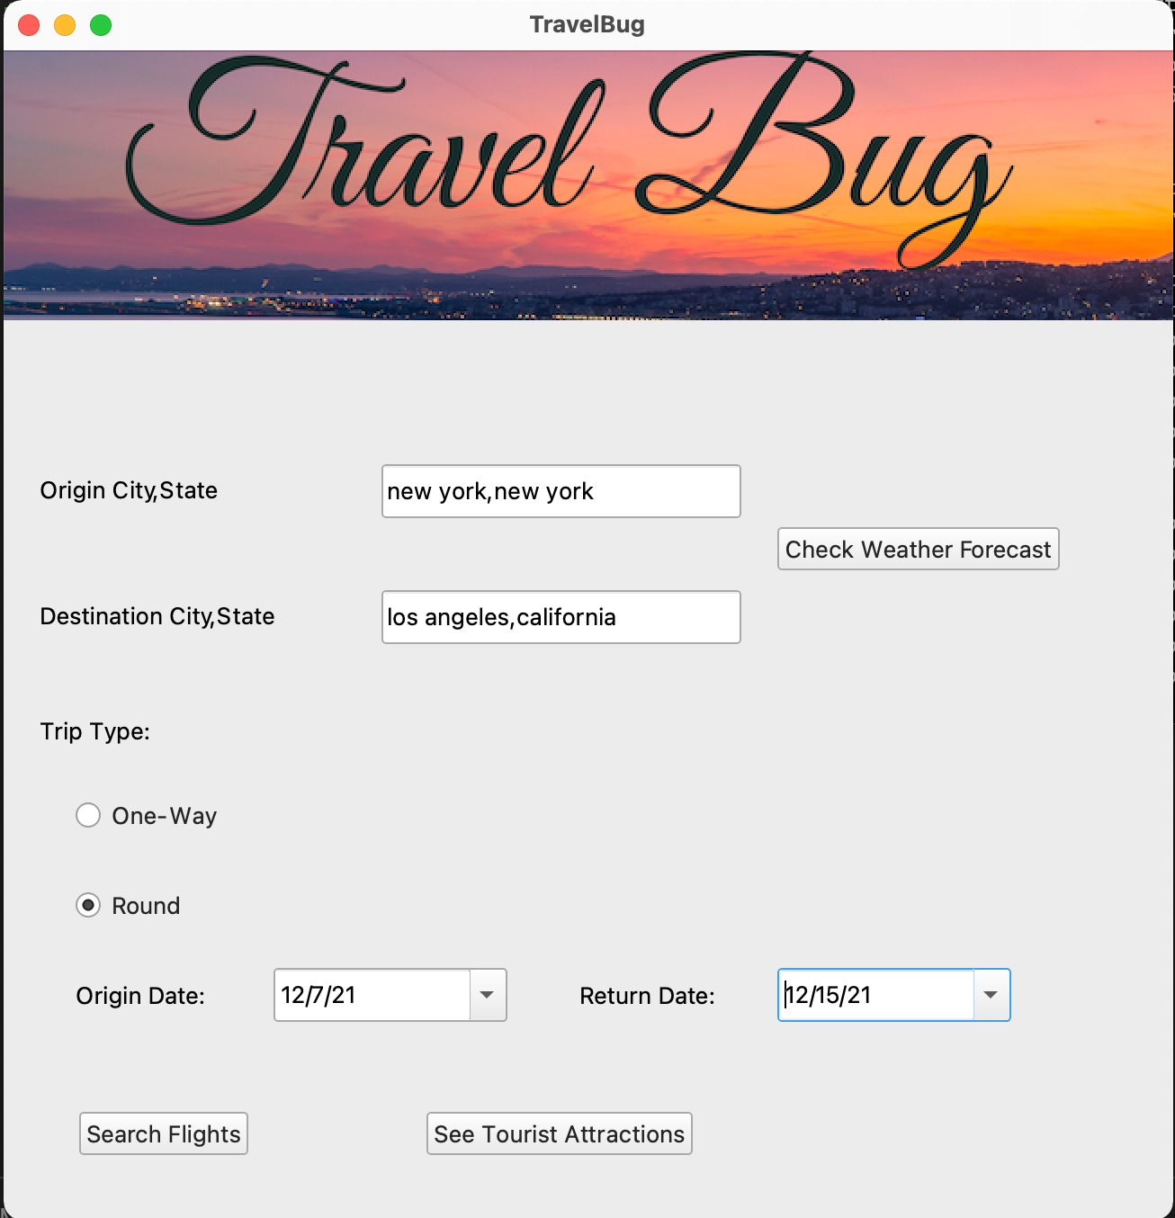
Valid User Input
Look up CSV for source and destination city state authenticity
Reference :
US-cities (28,400 entries)
Origin Date cannot be older than current date
Return Date cannot be older than Origin Date

Slide 6
Flights
Web scraping using Selenium and BeautifulSoup
Filtering on best flight options available
Retrieving all flight details for both journeys
Sorted on price (cheapest -> most expensive)
Resources
KAYAK (online travel agency and metasearch engine)
US-Airports CSV (containing 28,000 entries)

Slide 7
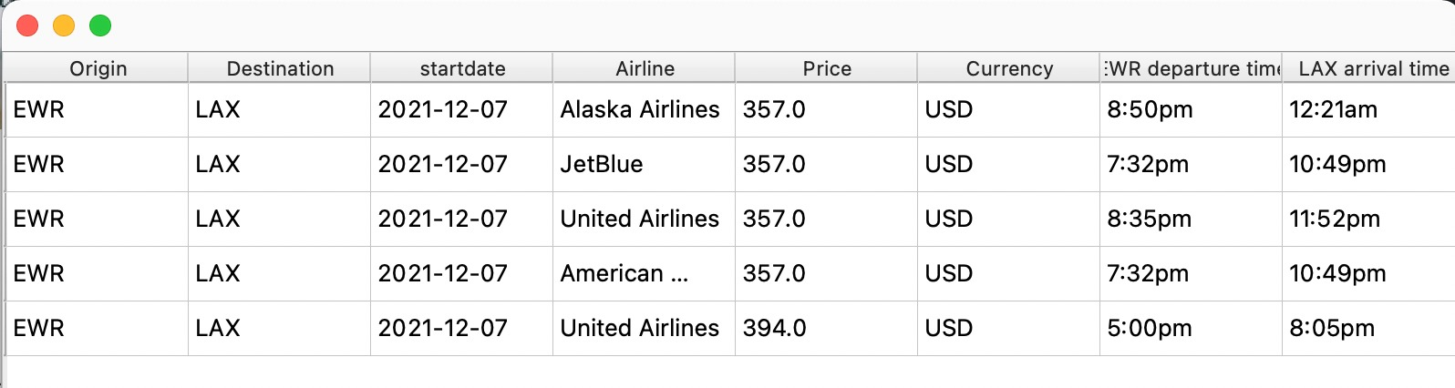
Flight Options
One-Way Trip

Slide 8
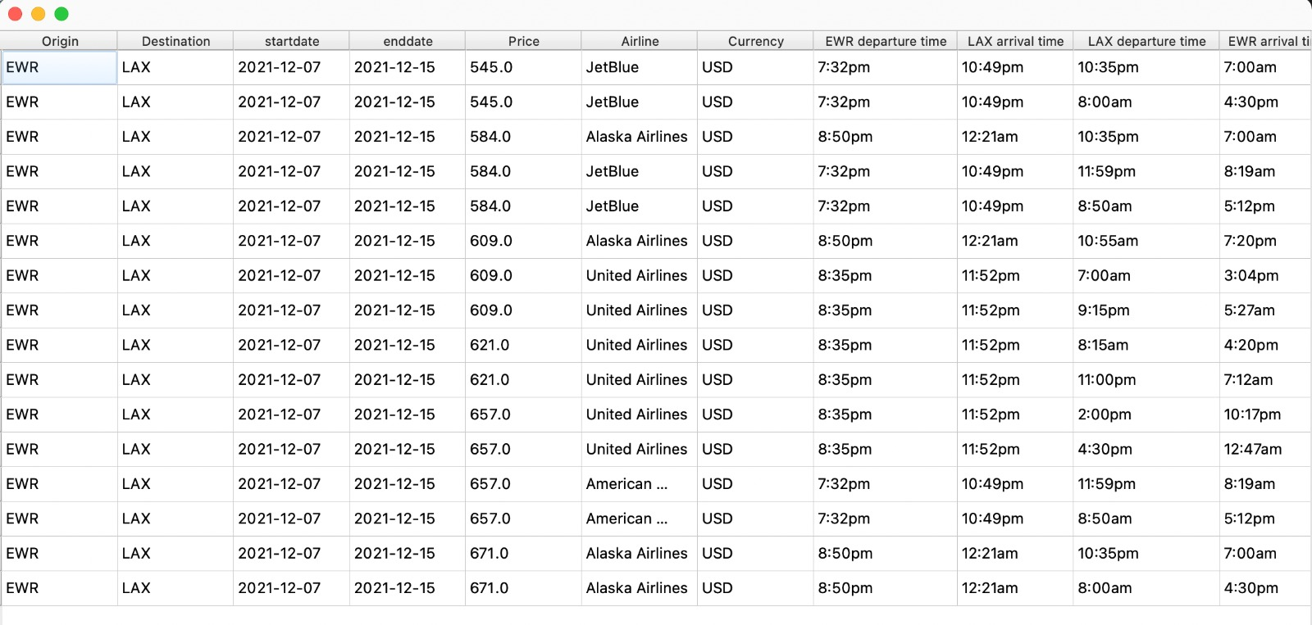
Flights Options
Round Trip

Slide 9
Weather Forecast
API to get forecast for next 5 days
Description and status with interactive logos
Temperature parameters (min, max, avg)
Resources
OpenWeatherMap API (global weather model)

Slide 10
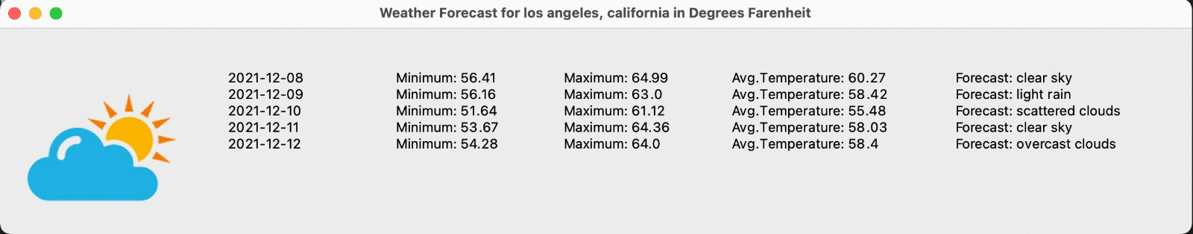
Weather Forecast

Slide 11
Tourist Attractions
Fetching top tourist attractions from destination city through web scraping
Getting latitude, longitude of each tourist spot using API
Geo-spatial clustering using k-means algorithm
Resources
Website – Attractions of America
OpenStreetMap API for raw geodata

Slide 12
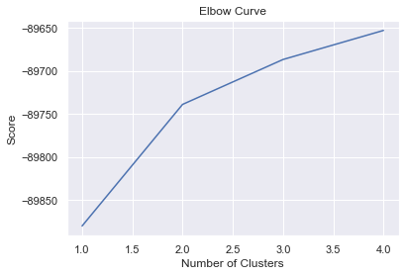
Elbow Curve
Each inflection point differentiates clusters
Runs k-means clustering on dataset for range k
Calculates Sum of Squared Errors (SSE) for each k

Slide 13
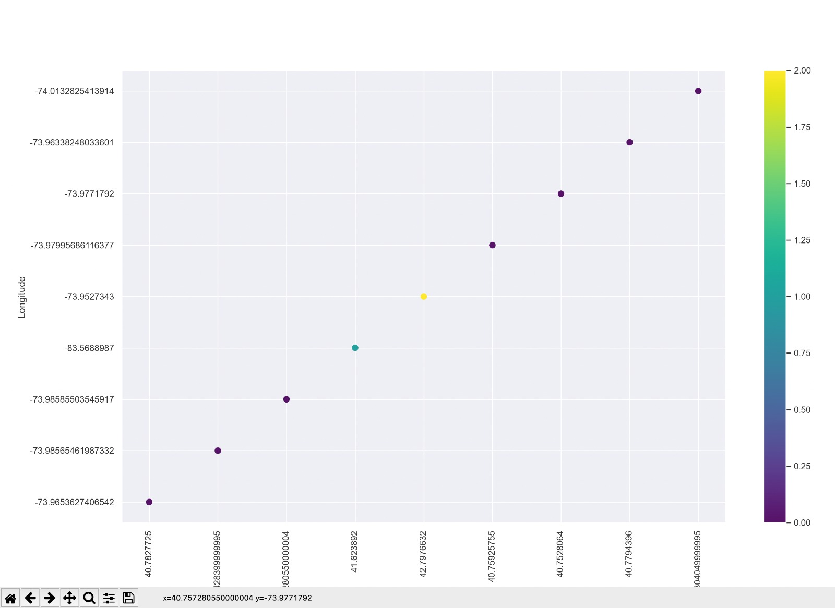
Geo-spatial Clustering
Assigning clusters based on tourist spot location
Designated colors depict unique clusters

Slide 14
References
Validating User input
https://simplemaps.com/data/us-cities
Weather API
https://openweathermap.org/api
Flight Scraping
https://www.kayak.com/flights
https://towardsdatascience.com/scraping-flight-data-using-python-e71b97e859d3
https://data.humdata.org/dataset/ourairports-usa
Geo-spatial clustering
https://levelup.gitconnected.com/clustering-gps-co-ordinates-forming-regions-4f50caa7e4a1
https://www.attractionsofamerica.com/attractions/
https://nominatim.openstreetmap.org/ui/search.html

Slide 15
Thank you!

